Slide 1
DEVELOPMENT OF AN ONLINE AUTOMATED ATTENDANCE SYSTEM USING FACIAL RECOGNITION FOR BAZE UNIVERSITY, ABUJA
BY
ALIYU MUSA LABARAN
BU/21A/IT/5374
MAY, 2024

Slide 2
BACKGROUND
Attendance tracking has been a fundamental aspect of educational institutions for many years, and its methods have evolved over time. The traditional approach to attendance management involved manual processes, such as taking roll call in classrooms and manually recording attendance data on paper registers (Liu, Yang, & Liu, 2019). These paper-based systems were time-consuming, prone to errors, and made it challenging to retrieve and analyze attendance data efficiently.

Slide 3
MOTIVATION
The motivation for developing an Online Automated Attendance System arises from the limitations and inefficiencies of manual and early digital attendance tracking methods. The need for a more efficient, accurate, and real-time attendance management system has become increasingly evident. Educational institutions, including Baze University in Abuja, recognize the potential benefits of implementing an automated system to streamline attendance tracking processes and improve overall efficiency (Liu, Yang, & Liu, 2019).

Slide 4
STATEMENT OF THE PROBLEM
The existing manual attendance tracking system at Baze University is labor-intensive, time-consuming, and error-prone. The process involves manual collection of attendance data, which is then inputted into spreadsheets or other record-keeping tools. This manual approach poses several challenges, including the potential for data entry errors, difficulties in data retrieval and analysis, and delays in generating attendance reports. Furthermore, the lack of a real-time monitoring mechanism hampers the university's ability to promptly address attendance-related issues or identify trends and patterns.

Slide 5
AIM AND OBJECTIVES OF THE STUDY
The aim of this project is to develop an Online Automated Attendance System for Baze University, Abuja, with the following objectives:
The Objectives include:
To automate the process of capturing and recording student attendance.
To provide real-time access to attendance records for faculty, administrators, and students.
To generate comprehensive attendance reports and analytics for decision-making.
To enhance efficiency in attendance management and reduce administrative workload.
To improve accuracy and eliminate errors associated with manual attendance tracking methods.

Slide 6
SIGNIFICANCE OF THE STUDY
The development of an Online Automated Attendance System holds significant importance for Baze University and other educational institutions. The system's implementation will result in numerous benefits, such as:
Improved Efficiency
Real-Time Monitoring
Enhanced Transparency and Accountability

Slide 7
PROJECT RISK ASSESSMENT
Risk | Description | Impact
Technical Challenges | Potential technical difficulties in system development and deployment, including compatibility issues, data security concerns, and scalability challenges. | Delayed project timeline, increased development costs, compromised data security.
User Adoption | Resistance or reluctance from faculty, administrators, and students towards adopting and adapting to the new system. | Incomplete or inconsistent data input, reduced system utilization, limited benefits realization.
Data Integrity | Risks associated with maintaining data integrity, preventing unauthorized access or manipulation of attendance records. | Compromised data accuracy, potential privacy breaches, loss of trust in the system.

Slide 8
LITERATURE REVIEW
This section presents a comprehensive review of the literature related to the development of an Online Automated Attendance System. The literature review aims to provide a contextual understanding of the historical evolution of attendance management systems and highlight the existing research and practices in this field. By examining previous studies and related work, this chapter establishes a foundation for the current project and identifies gaps that the proposed system intends to address.

Slide 9
HISTORICAL OVERVIEW
The history of attendance management systems can be traced back to manual methods of recording attendance, such as paper-based registers and roll call. These traditional approaches were labor-intensive, time-consuming, and prone to errors. However, with the emergence of technology, educational institutions began exploring digital solutions to streamline attendance tracking processes.

Slide 10
REVIEW OF RELATED LITERATURE
Study | Method Used | Strengths | Weaknesses
Kumar and Srivastava (2017) | Face recognition | Automated attendance tracking, reduced manual work | Requires image processing software and hardware, privacy concerns
Liu, Yang, and Liu (2019) | RFID technology | Accuracy, efficiency, real-time monitoring | Cost of RFID tags, specialized RFID readers required
Bin Anuar, Zainal, and Yussof (2018) | QR code scanning | Ease of implementation, user-friendly | Requires mobile devices with cameras, QR codes need to be generated and placed
Chatterjee, Mitra, and Bhattacharya (2018) | Mobile app with GPS | Convenience, accessibility | Reliant on GPS accuracy, requires constant internet connectivity

Slide 11
REVIEW OF RELATED LITERATURE
Al-Fahad, Al-Shammari, and Al-Hajraf (2016) | Fingerprint biometric authentication | Improved security, real-time monitoring | Additional biometric hardware required, user acceptance issues
Yasin, Ahmad, and Hamzah (2018) | Cloud-based system | Scalability, accessibility, data security | Reliant on internet connectivity, potential data privacy risks
Mahajan, Kaur, and Singh (2018) | Iris recognition | Highly accurate identification | Specialized iris scanning hardware required, slower process
Gupta and Gupta (2017) | Facial recognition with machine learning | Automated face recognition, continuous self-learning | Complex algorithms, large training datasets required

Slide 12
REVIEW OF RELATED LITERATURE
Jain and Keskar (2016) | Wireless sensors | Automated attendance tracking | Installation of sensors in each classroom needed
Srinivasan and Prakash (2018) | RFID + WSN | Automated tracking, no student participation needed | Cost of hardware, power requirements
Hassan, Khan, and Khan (2020) | Machine learning algorithms | Predictive capabilities, absenteeism tracking | Requires large datasets, complex modeling
Chaudhary, Bhatt, and Bhatt (2018) | Data analytics on attendance data | Useful insights from trends and correlations | Skilled data analysis needed
Banaei and Mosadegh (2016) | Cloud-based system | Remote access, centralized storage | Reliant on internet connectivity

Slide 13
SUMMARY OF RELATED WORKS
The literature review provided a comprehensive overview of the historical evolution and current landscape of attendance management systems. It is evident that the field has progressed from manual paper-based methods to automated online systems utilizing advanced technologies like biometrics, RFID, GPS, etc.
The review of related studies highlighted the diverse approaches and technologies that can be leveraged to develop online automated attendance systems. Each approach offers unique advantages and use cases. Factors like accuracy, efficiency, accessibility, security, scalability need to be evaluated when selecting an appropriate technology.

Slide 14
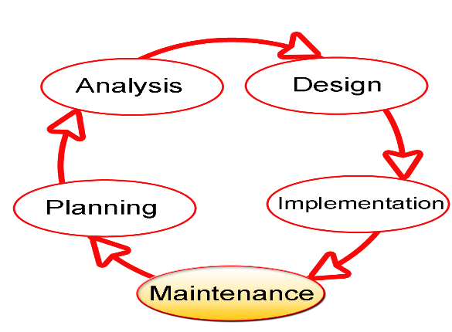
REQUIREMENTS, ANALYSIS, AND DESIGN
Proposed Model
SDLC stands for Software Development Life Cycle, and it is a systematic procedure for developing software that assures its quality and accuracy. The goal of the SDLC process is to develop high-quality software that fulfills client requirements. The system should be developed within the schedule and budget constraints. SDLC is a step-by-step process that describes how to design, develop, and maintain software.

Slide 15
REQUIREMENT ANALYSIS
SOFTWARE REQUIREMENTS
Operating System: Windows
Database: SQLite
Server: Django
Application program: Notepad++
Python
HARDWARE REQUIREMENTS
HP
8GB RAM
500GB hard disk
Browser

Slide 16
FUNCTIONAL SPECIFICATION REQUIREMENT
ID | Requirement | Description
F1 | Student management | Tools for student registration, managing student profiles, courses etc.
F2 | Faculty management | Managing faculty availability, schedules, students assigned etc.
F3 | Attendance tracking | Automated student attendance at classes based on ID/Facial Recognition.
F4 | Reporting | Administrative reports on attendance, student records, course records etc.

Slide 17
NON-FUNCTIONAL SPECIFICATION REQUIREMENT
ID | Requirement | Description
NF1 | Usability | Intuitive interface and navigation for diverse users including students, faculty, and administrators.
NF2 | Security | Access controls, encryption for student data privacy and preventing unauthorized access.
NF3 | Accuracy | Validation of inputs, checks in workflows to ensure accurate attendance records.
NF4 | Scalability | Ability to handle increased users and data as university grows.
NF5 | Availability | 24x7 access with minimal downtime.

Slide 18
APPLICATION ARCHITECTURE
URL
Login
Attendance View
Dashboard
Add Student Profile
Take Attendance
Reporting
Logout

Slide 19
USECASE DIAGRAM
Login
Register Student Profile
Login
Take Attendance
Take Attendance
Reporting
Logout
Logout
Student

Slide 20
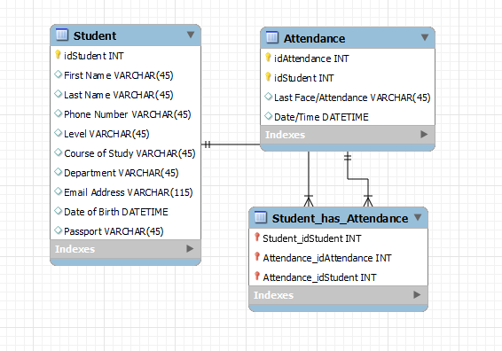
ENTITY RELATIONSHIP DIAGRAM

Slide 21
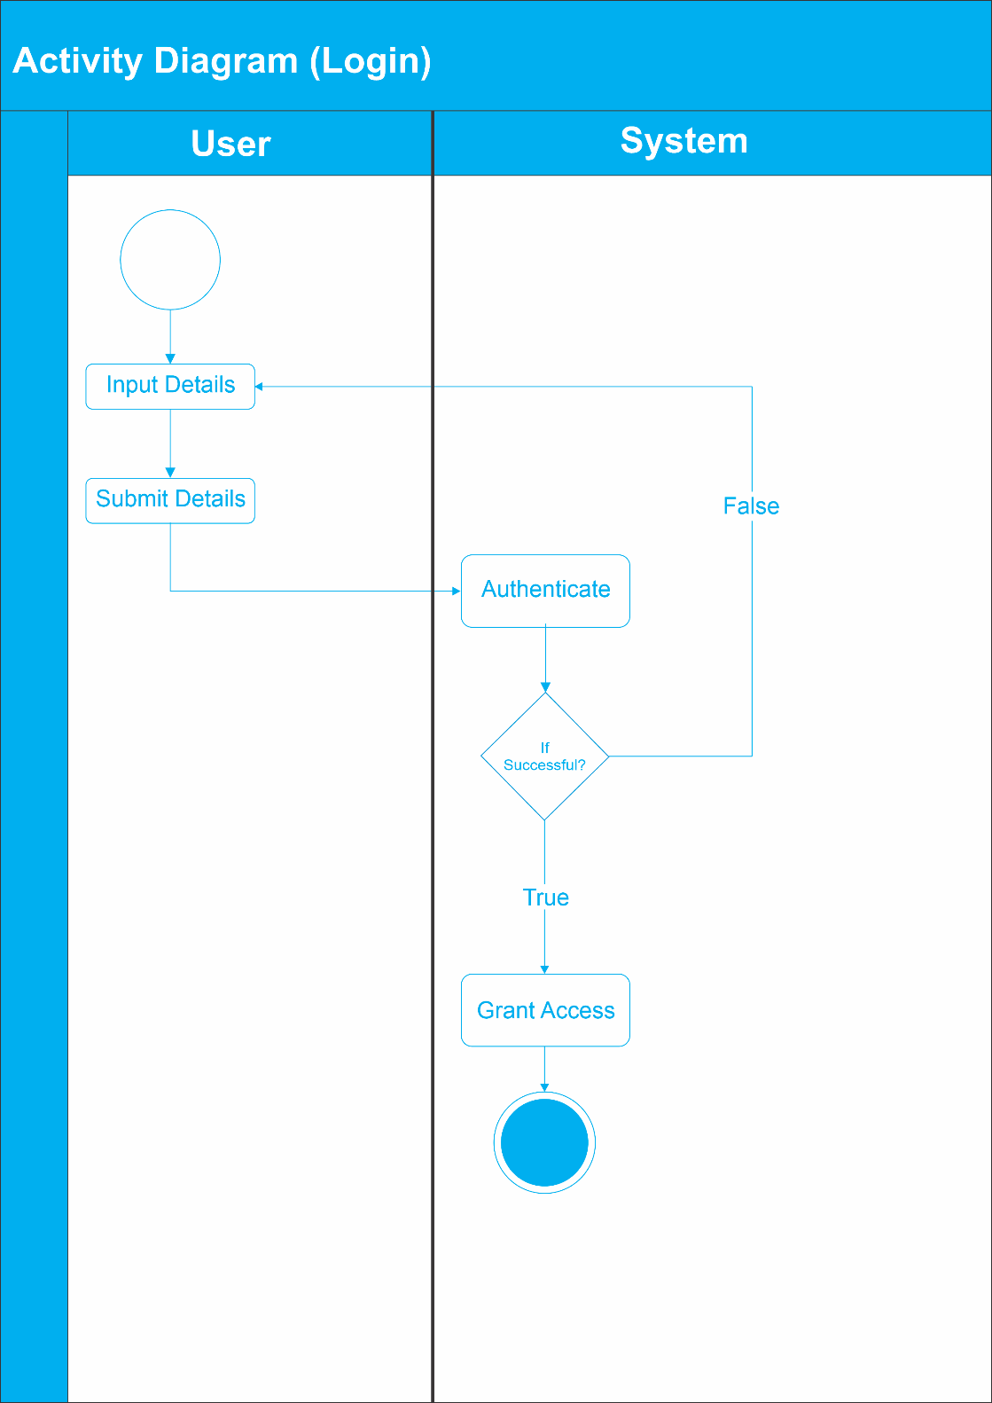
ACTIVITY DIAGRAM

Slide 22
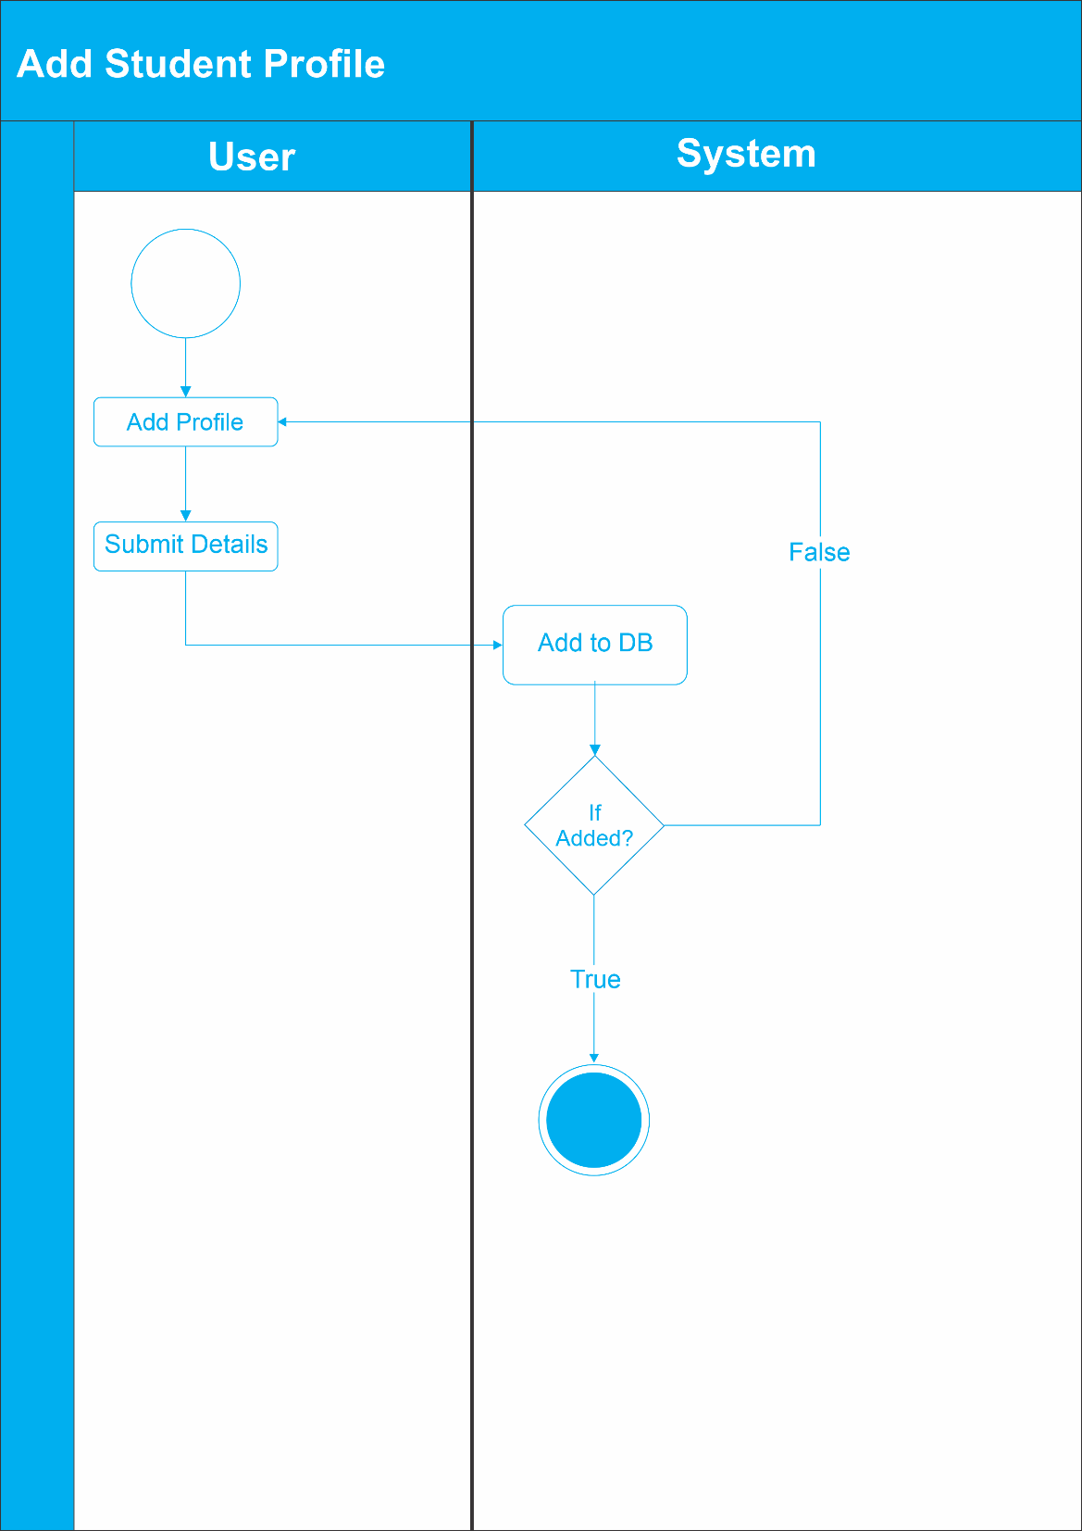
ACTIVITY DIAGRAM

Slide 23

ACTIVITY DIAGRAM

Slide 24
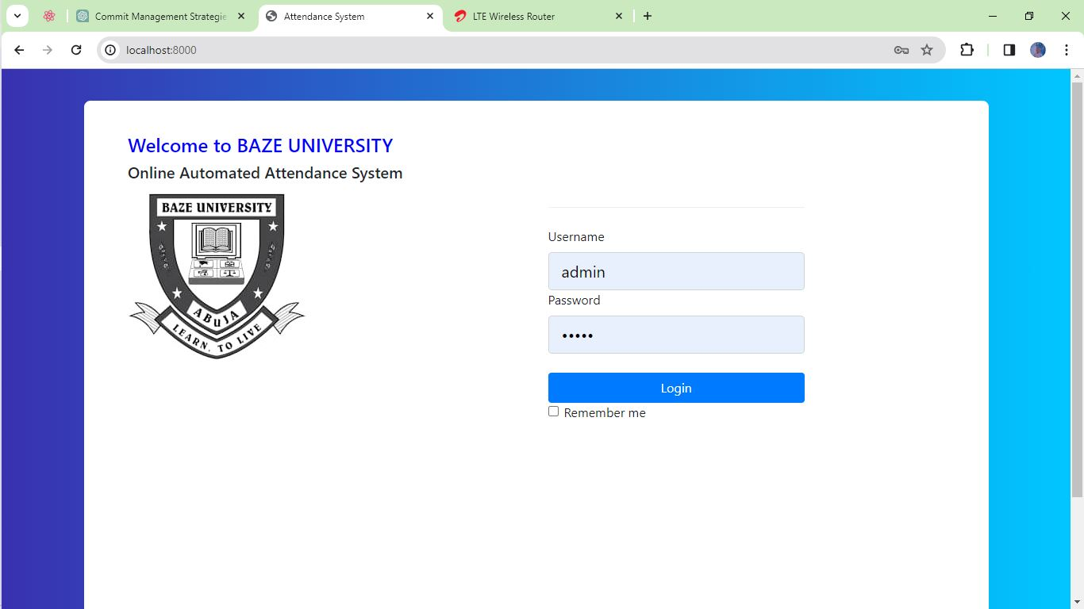
USER INTERFACE

Slide 25
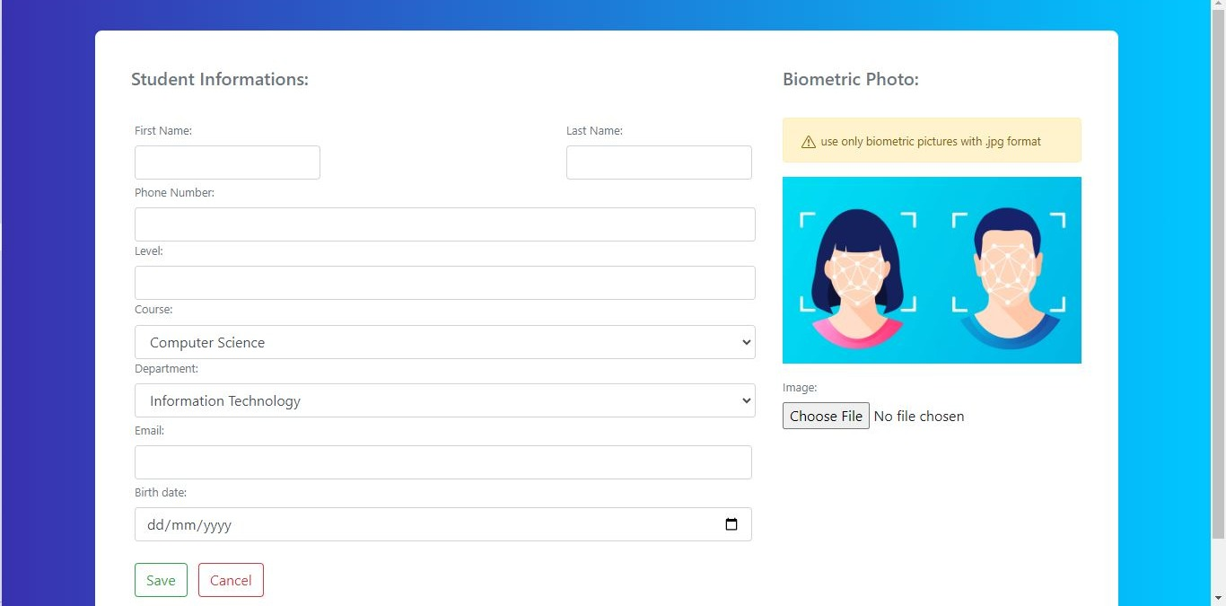
USER INTERFACE

Slide 26
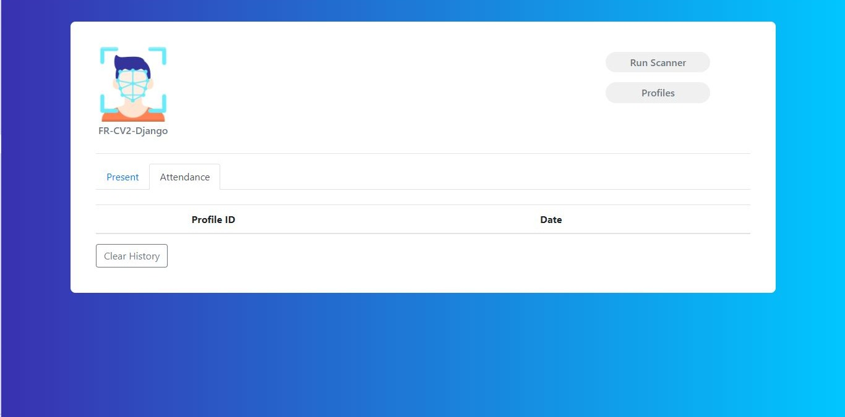
USER INTERFACE

Slide 27
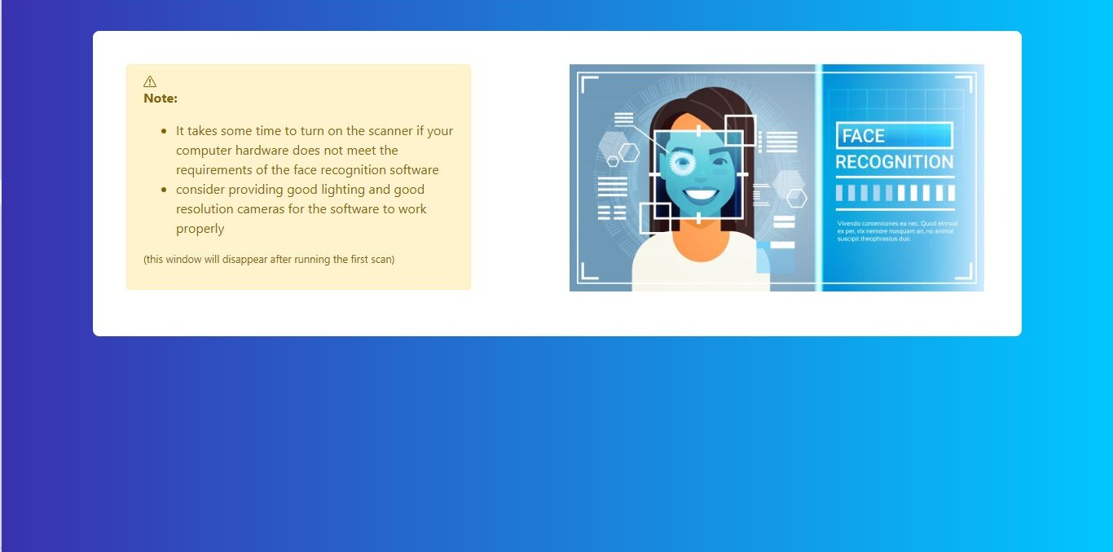
USER INTERFACE

Slide 28
TESTING
Test Case | User Login
Related Requirement | FR01
Prerequisites | - User has a valid account - User has access to the login page
Test Procedure | 1. Navigate to the login page 2. Enter valid username and password 3. Click on the "Login" button
Test Data | - Valid username and password
Expected Result | - User logged in successfully
Actual Result | User logged in successfully
Status | Pass
Remark | None
Created By | Aliyu Musa Labaran
Date of Creation | 7th April, 2024
Executed By | Aliyu Musa Labaran
Date of Execution | 7th April, 2024
Test Environment | Laptop Computer

Slide 29
TESTING
Test Case | Take Attendance
Related Requirement | FR02
Prerequisites | - Instructor logged into the system - Access to the attendance management section - Students' face data registered in the system
Test Procedure | 1. Navigate to the "Take Attendance" 2. Select the class or group 3. Click on the "Start Attendance" button 4. Instruct students to align their faces with the camera 5. The system will automatically mark the attendance for recognized Students 6. Review the attendance report
Test Data | - Students' face data
Expected Result | - Attendance taken successfully
Actual Result | Attendance taken successfully
Status | Pass
Remark | None
Created By | Aliyu Musa Labaran
Date of Creation | 7th April, 2024
Executed By | Aliyu Musa Labaran
Date of Execution | 7th April, 2024
Test Environment | Laptop Computer with Webcam

Slide 30
TESTING
Test Case | Add Student Profile
Related Requirement | FR01
Prerequisites | - Admin logged into the system - Access to the student profile management section - Student details
Test Procedure | 1. Navigate to the " Student Profiles" section 2. Click on the "Add Student" button 3. Enter the student details 4. Capture the student's face using the webcam 5. Click on the "Save" button
Test Data | - Student details - Students' face data
Expected Result | - Student profile added successfully
Actual Result | Student profile added successfully
Status | Pass
Remark | None
Created By | Aliyu Musa Labaran
Date of Creation | 7th April, 2024
Executed By | Aliyu Musa Labaran
Date of Execution | 7th April, 2024
Test Environment | Laptop Computer with Webcam

Slide 31
TESTING
Test Case | View Attendance
Related Requirement | FR02
Prerequisites | - Admin logged into the system - Access to the attendance management section
Test Procedure | 1. Navigate to the "Attendance" section 2. Select the class, group, or individual attendance report 3. View the attendance details
Test Data | - Attendance records
Expected Result | - Attendance report displayed successfully
Actual Result | Attendance report displayed successfully
Status | Pass
Remark | None
Created By | Aliyu Musa Labaran
Date of Creation | 7th April, 2024
Executed By | Aliyu Musa Labaran
Date of Execution | 7th April, 2024
Test Environment | Laptop Computer

Slide 32
TESTING
Test Case | User Logout
Related Requirement | FR01
Prerequisites | - User logged into the system
Test Procedure | 1. Click on the user profile or menu 2. Select the "Logout" option
Test Data | N/A
Expected Result | - User logged out successfully
Actual Result | User logged out successfully
Status | Pass
Remark | None
Created By | Aliyu Musa Labaran
Date of Creation | 7th April, 2024
Executed By | Aliyu Musa Labaran
Date of Execution | 7th April, 2024
Test Environment | Laptop Computer

Slide 33
SUMMARY/CONCLUSION
The development of the Online Automated Attendance System with facial recognition technology for Baze University was a comprehensive endeavor that successfully achieved its primary objectives. The system effectively automated the attendance tracking process using facial recognition, provided real-time access to attendance records, generated comprehensive reports and analytics, enhanced efficiency, and improved accuracy compared to manual attendance tracking methods.
While the project faced challenges related to facial data collection and management, recognition accuracy, privacy and ethical concerns, infrastructure requirements, and user acceptance, the development team employed effective strategies to overcome these challenges and deliver a functional and reliable system.

Slide 34
REFERENCES
Abdullah, A. F., Salleh, M. N. M., & Ismail, A. (2018). RFID-based student attendance management system. Indonesian Journal of Electrical Engineering and Computer Science, 10(1), 371-379.
Al-Fahad, F. N., Al-Shammari, Z., & Al-Hajraf, A. (2016). An online system for college attendance management using RFID. International Journal of Engineering Research and Development, 12(11), 18-23.
Bajaj, M., Singh, S. K., & Saini, H. P. (2018). Smart classroom attendance management system based on Bluetooth beacons. In 2018 IEEE International Conference on Internet of Things and Intelligence System (IOTAIS) (pp. 148-153). IEEE.
Banaei, M. B., & Mosadegh, B. M. (2016). Cloud based attendance management information system. Journal of Humanities Insights, 1(01), 1-6.
Bhatia, T., Gupta, P., & Kumar, N. (2017). GPS based mobile attendance management system. International Journal of Computer Applications, 160(7), 6-10.
Bin Anuar, N. A., Zainal, N., & Yussof, S. (2018). Prototype of online student attendance management system using QR code scanning. Indonesian Journal of Electrical Engineering and Computer Science, 10(1), 299-306.

Slide 35
Chatterjee, S., Mitra, S., & Bhattacharya, I. (2018). Student attendance management system for classroom using mobile application. International Journal on Recent and Innovation Trends in Computing and Communication, 6(8), 32-35.
Chaudhary, A., Bhatt, N., & Bhatt, R. (2018). Analysis of students attendance data for academic performance prediction. International Journal of Engineering and Technology(UAE), 7(2.7), 135-138.
Chong, A., Lai, R., & Wong, K. (2018). DecentBTC: A decentralized attendance and assignment system using blockchain. In 2018 International Carnahan Conference on Security Technology (ICCST) (pp. 1-6). IEEE.
Doshi, R. K., Kumavat, N. J., & Rathod, H. N. (2018). Android application for student attendance management system. International Journal of Computer Sciences and Engineering, 6(3), 74-76.
Gupta, P., & Gupta, B. (2017). Face recognition attendance system. International Journal of Advanced Research in Computer and Communication Engineering, 6(2), 197-201.
Hassan, R., Khan, I. U., & Khan, U. (2020). Predicting student attendance using decision trees and random forests. In 2020 International Conference on Engineering and Emerging Technologies (ICEET) (pp. 1-6). IEEE.

